Slide 1
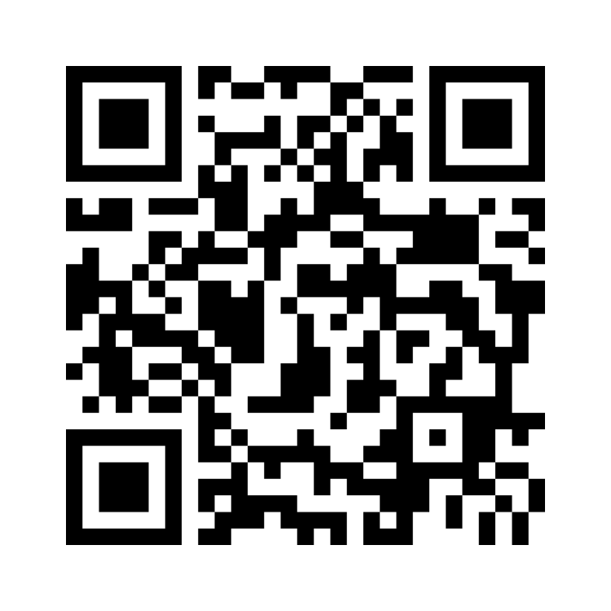
Southend High School for Girls
A quick activity: word association
Using the QR code below, please share which words you associate with the term mental health.
Safe Happy Successful

Slide 2
Southend High School for Girls
World Mental Health Day 2022

Slide 3
Southend High School for Girls
Introductions:
Mrs Dexter - Our very own school student counsellor
Miss Marcel – senior mental health lead – for students and staff
Safe Happy Successful

Slide 4
Southend High School for Girls
This year’s focus:
“Make mental health & well-being for all a global priority”
Safe Happy Successful

Slide 5
Southend High School for Girls
A quick activity: word association
Using the QR code below, please share which words you associate with the term mental health.
What you said:
Safe Happy Successful

Slide 6
Southend High School for Girls
Mental health is not merely the absence of illness.
Mental health is our emotional, psychological, and social well-being.
It affects how we think, feel, and act.
It also helps determine how we handle stress, relate to others, and make choices.
Mental health is important at every stage of life, from childhood and adolescence through to adulthood.
Safe Happy Successful

Slide 7
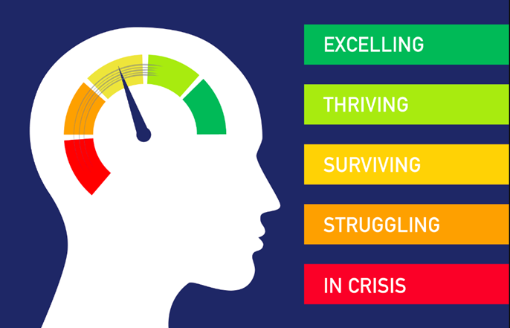
Southend High School for Girls
Well-being is not being constantly happy.
Feeling sad does not mean we are suffering from a disorder.
We are all on a continuum.
Safe Happy Successful

Slide 8
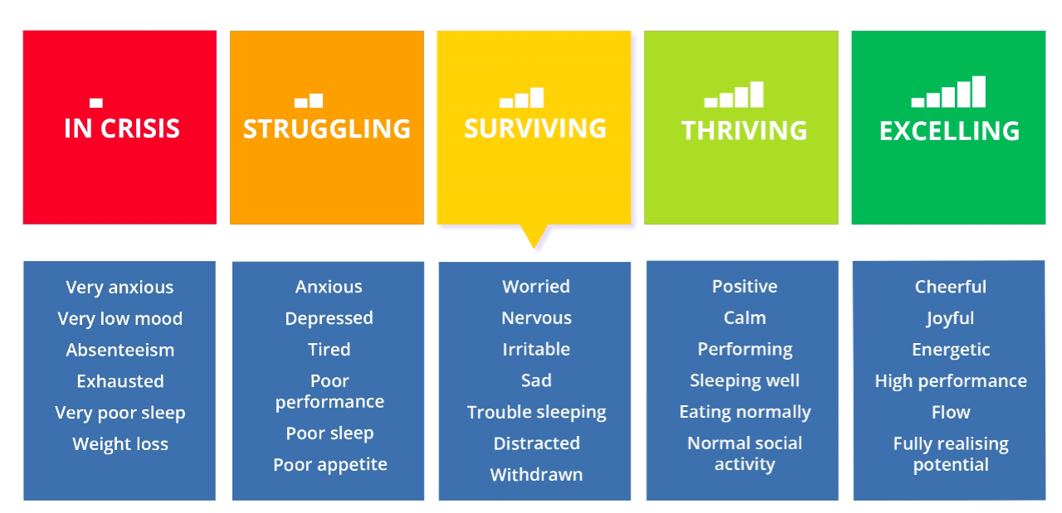
Southend High School for Girls
What is a mental health continuum?
Safe Happy Successful

Slide 9
Southend High School for Girls
How can I keep mentally healthy?
5 ways to well-being
Safe Happy Successful

Slide 10
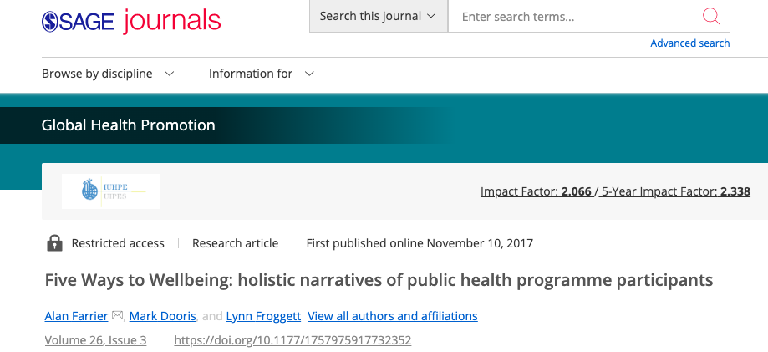
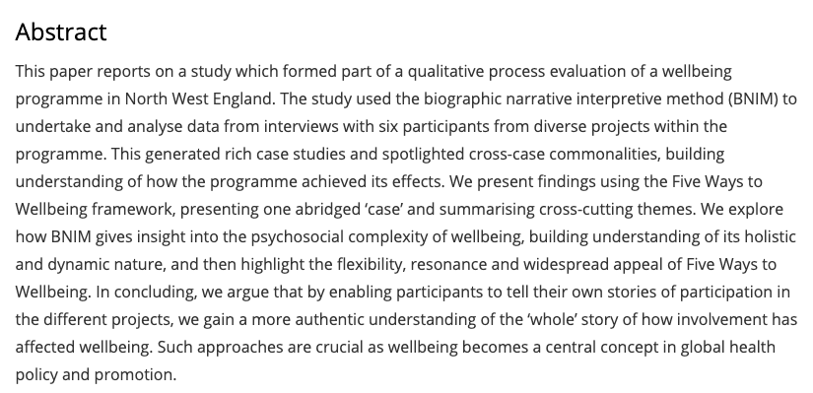
Southend High School for Girls
Safe Happy Successful

Slide 11
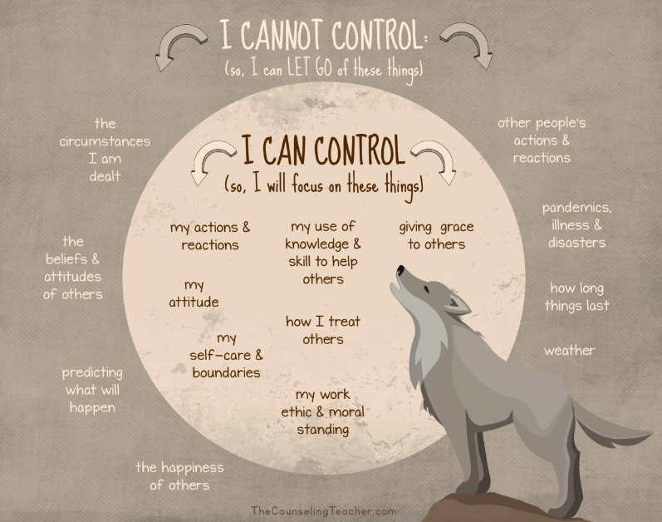
Southend High School for Girls
Safe Happy Successful

Slide 12
Southend High School for Girls
Key messages:
Research shows that looking after ourselves can prevent developing mental distress.
Be kind to yourself and to others.
You are not alone – we all are responsible for our health but we can help each other too.
Remember the continuum. “This too shall pass”.
Learn to let go! Forget about the things which are outside of your circle of control.
In school support:
Resources (I will send you a toolkit now), useful numbers, the school padlets (I will send link out again today), 5 ways to well-being, healthy living/ self care campaigns…
Yourself, your friends and colleagues, peer support (mental health first aiders), your tutors or line managers, the safeguarding lead, your PSOs and Heads of years, the school nurse, referral to Mrs Dexter, referrals to MHST, support from the SENDco and Miss Marcel.
Safe Happy Successful

